Slide 1
Circle Drawings

Slide 2

Circle Drawing
Since the circle is a frequently used component in pictures and graphs, a procedure for generating either full circles or circular arc is included in most graphics packages.
Direct Algorithm
The equation for a circle is:
x² + y² = r²
Where r is the radius of the circle. So, we can write a direct circle drawing algorithm by solving the equation for y at unit x intervals using:
y = ±(r² – x²)^{1/2}
2

Slide 3

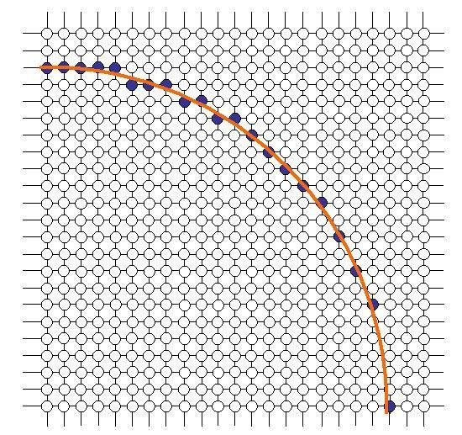
Direct Algorithm
To draw a circle with radius=20
y(0) = ±(20² – 0²)^{1/2} ≅ 20 y(1) = ±(20² – 1²)^{1/2} ≅ 20 y(2) = ±(20² – 2²)^{1/2} ≅ 20
…..
y(19) = ±(20² – 19²)^{1/2} ≅ 6
y(20) = ±(20² – 20²)^{1/2} = 0
the resulting circle has large gaps where the slope approaches the vertical. And the calculations are not very
efficient:
The square (multiply) operations
The square root operation
3

Slide 4
Mid-Point Circle Algorithm
As in the raster line algorithm, we sample at unit intervals and determine the closest pixel position to the specified circle path at each step.
For a given radius r and screen center position (x_{c}, y_{c}), we can first set up our algorithm to calculate pixel positions around a circle path centered at the coordinate (0, 0).
Then each calculated position (x, y) is moved to its proper screen position by adding x_{c} to x and y_{c} to y.
5

Slide 5
Mid-Point Circle Algorithm
Along the circle section from x = 0 to x = y in the first quadrant, the slope of the curve varies from 0 to –1. Therefore, we can take unit steps in the positive x direction over this octant and use a decision parameter to determine which of the two possible y positions is closer to the circle path at each step positions in the other seven octants are then obtained by symmetry.
To apply the midpoint algorithm, we define a circle function:
p_{circle}(x, y) = x² + y² – r²
6

Slide 6
Mid-Point Circle Algorithm
The relative position of any point (x, y) can be determined by checking the sign of the on the boundary of the circle function:
< 0
p_{circle}(x, y) = 0
> 0
If (x, y) is inside the circle boundary
If (x, y) is on the circle boundary
If (x, y) is outside the circle boundary
The circle function tests are performed for the midpoints positions between pixels near the circle path at each sampling step. Thus, circle function is decision parameter in the midpoint algorithm, and we can set up incremental calculations for this function as we did in the line algorithm.
7

Slide 7
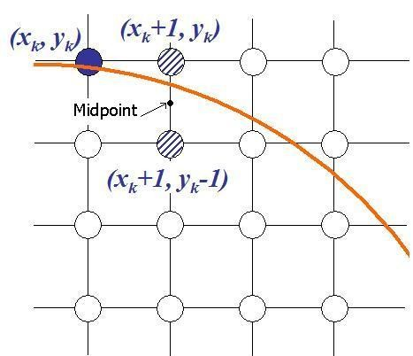
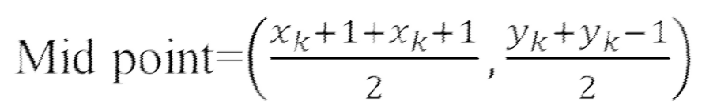
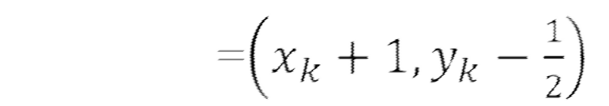
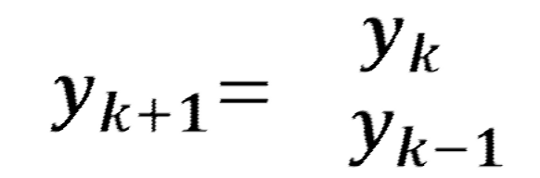
Mid-Point Circle Algorithm
Assuming we have just plotted point (x_{k}, y_{k}), we next need to determine whether the pixel at position (x_{k}+1, y_{k}) or the one at position (x_{k}+1, y_{k}–1) is closer to the circle path. Our decision parameter is The circle function evaluated at the
midpoint between these two pixels:
X_{k+1}=X_{k} +1
8

Slide 8
Mid-Point Circle Algorithm
p_{k} = f_{circle}(x_{k} + 1,y_{k} – 1/2)
=(x_{k} + 1)² + (y_{k} – 1/2)² – r²
Similarly
^{p}k+1
Now
=(x_{k+1} + 1)² + (y_{k+1} – 1/2)² – r²
p_{k+1} - p_{k}=(x_{k+1} + 1)²
=(x_{k+1} + 1)²
+ (y_{k+1} – 1/2)² – r² – (x_{k} + 1)² - (y_{k} – 1/2)² + r²
+ (y_{k+1} – 1/2)² – (x_{k} + 1)² - (y_{k} – 1/2)²
=((x_{k} +1) +1)² + (y_{k+1} – 1/2)² – (x_{k} + 1)² - (y_{k} – 1/2)²
=(x_{k} +1) ² + 1+2(x_{k} +1) + y_{k+1}² +1/4 – y_{k+1}– (x_{k} + 1)² – y_{k} – 1/4 +y_{k}
2
=1+2(x_{k} +1) + y_{k+1}² – y_{k+1}– y_{k} + y_{k}
2
p_{k+1} = p_{k}+ 2(x_{k} +1) + (y_{k+1}² – y_{k}² ) – (y_{k+1} – y_{k})+1
9

Slide 9

Mid-Point Circle Algorithm
p_{k+1} = p_{k}+ 2(x_{k} +1) + (y_{k+1}² – y_{k}² ) – (y_{k+1} – y_{k})+1 At Starting Point (0,r),
p_{k}=(x_{k} + 1)² + (y_{k} – 1/2)² – r²
=(0 + 1)² + (r – 1/2)² – r²
= 1 + r² + 1/4 – r – r²
= 5/4 – r
= 1 – r (take integral part)
Initial decision parameter p_{k}=1 – r
If p_{k} ≥ 0 => y_{k+1}=y_{k}-1 (mid point outside the circle)
So Next Pixel=(x_{k} + 1, y_{k} – 1)
If p_{k} < 0 => y_{k+1}=y_{k} (mid point inside the circle)
So Next Pixel=(x_{k} + 1, y_{k})
1
0

